Slide 1

How can Zip codes predict San Francisco Restaurant Inspection Scores?
Project 4 by: Chad Coggins, Jordan Goodrick, Dimitry Jean-Noel, Jake Treder, and Yolanda Williams

Slide 2

San Francisco, California
San Francisco, a food lover’s haven, boasts over 3,400 restaurants with diverse cuisines from clam chowder in sourdough bread bowls to authentic Chinese food in Chinatown.
While the city’s culinary scene is vibrant, ensuring food safety is equally critical.
Can zip codes, inspection scores, and violation ids predict the frequency of violations, demographic patterns, and restaurant type? Let’s find out with machine learning?

Slide 3
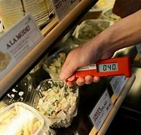
Exploring the Dataset
Dataset: Restaurant Inspection Scores (2016-2019) Rows:54K/Columns: 22
Data Provided by: San Francisco Department of Public Health
Source: http://www.sfdph.org/dph/EH/Food/score/default.asap
Dataset Owner: OpenData Portal
Inspection Data used: Zip codes, inspection scores, violation Ids, business name, address, inspection type, inspection date, inspection purpose, business latitude, business longitude, and business location.

Slide 4

Are there Any Visible Patterns Prior to deeper analysis?
Where are historically and recently problematic restaurants located?
Map visualizations made using Pandas and Folium
https://sites.google.com/view/tickettesting?usp=sharing

Slide 5
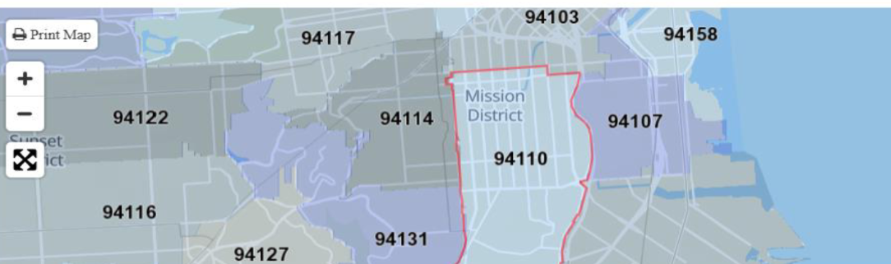
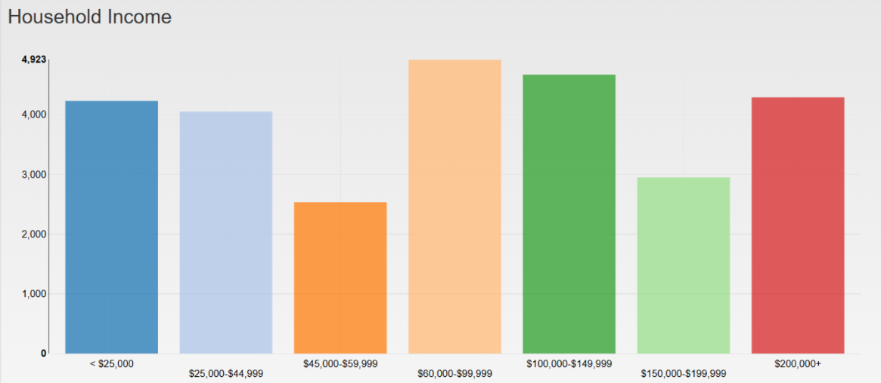
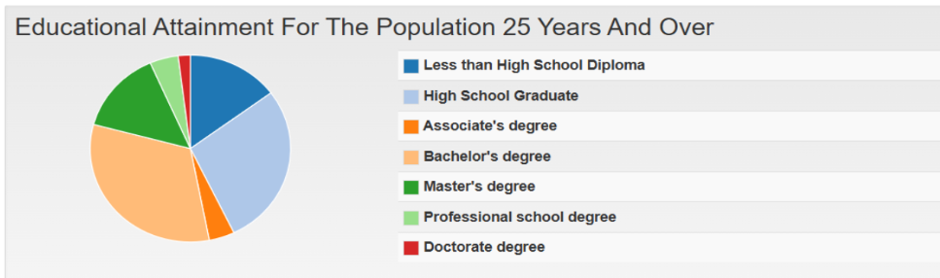
Demographic Patterns
Among all zip codes in San Francisco, 94110 stands out having the highest frequency of violations.

Slide 6

Question - How is a restaurant’s inspection score affected by ZIP Code in San Francisco?
Linear Regression
Using a Linear Regression model
Random Forest
Using a Random Forest model

Slide 7
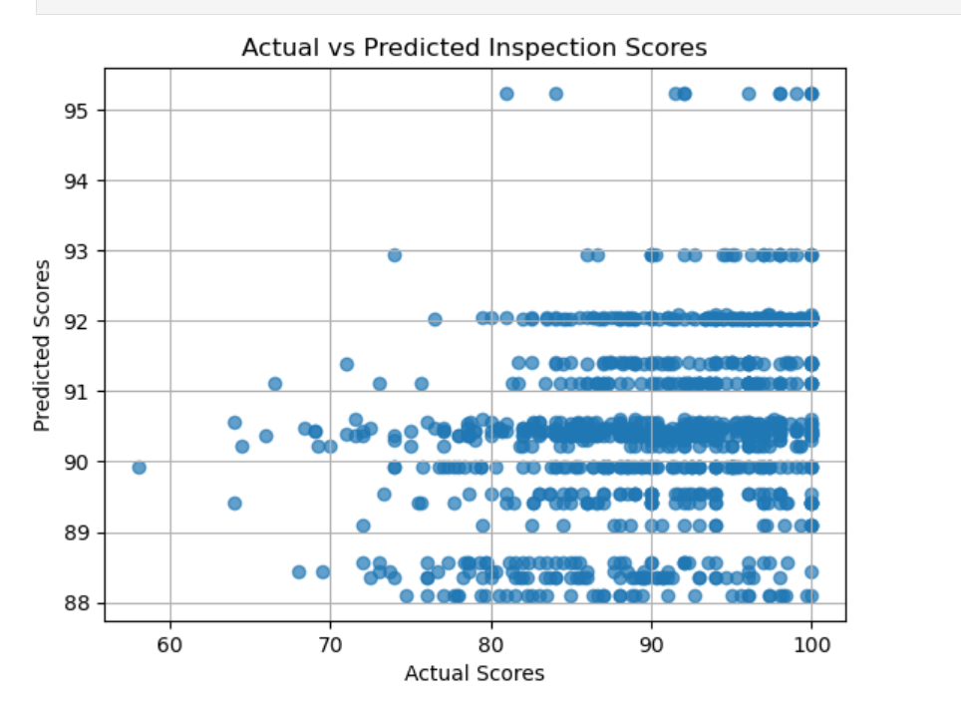
Random Forest Model
The predicted scores are tightly clustered in a narrow range (88-93), regardless of the actual scores. This suggests that the model is not capturing the full variability of the target variable (inspection scores).
In an ideal model, points would lie along the diagonal line y=x.

Slide 8
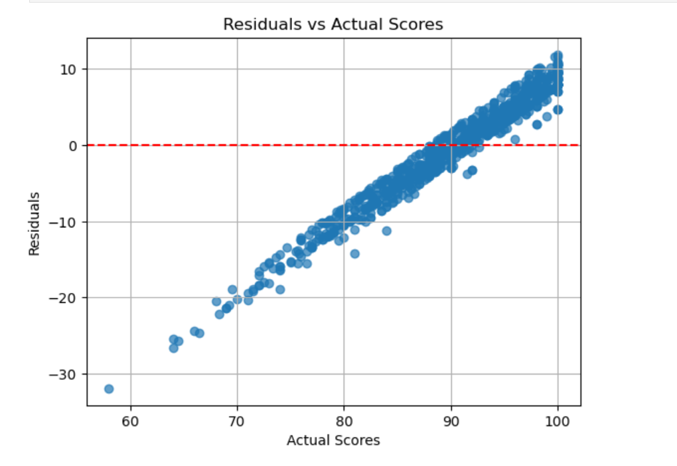
Linear Regression Model
The residuals are not randomly around the red horizontal line at y=0. Instead, they show clear pattern where:
For lower actual scores (e.g., below ~80), residuals are negative, meaning the model overpredicts.
For higher actual scores (e.g., above ~90), residuals are positive, meaning the model underpredicts.

Slide 9
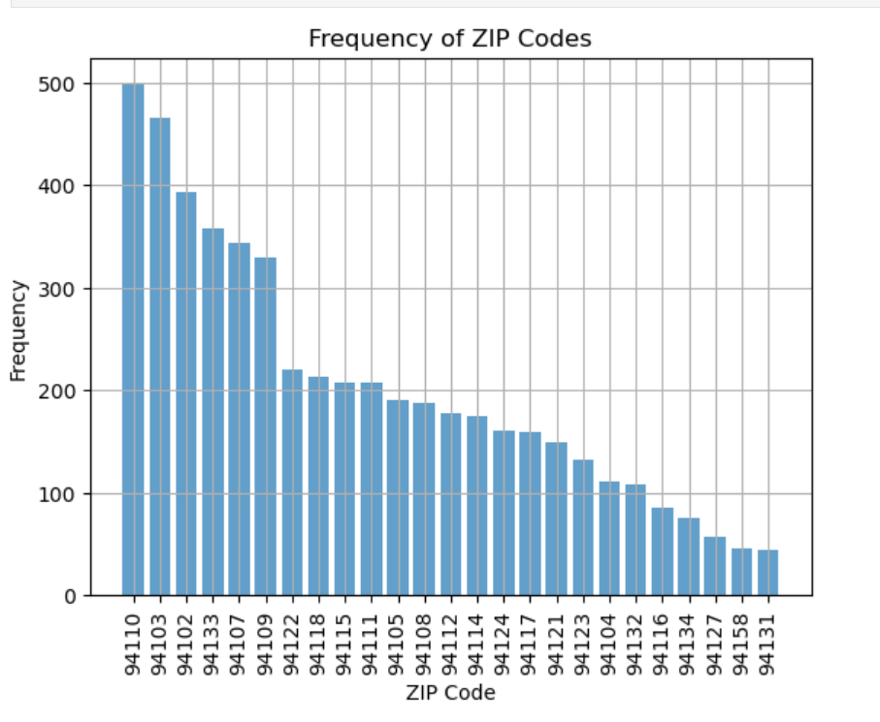
Frequency of ZIP Codes
Certain ZIP codes dominate the dataset which can make the model biased.

Slide 10
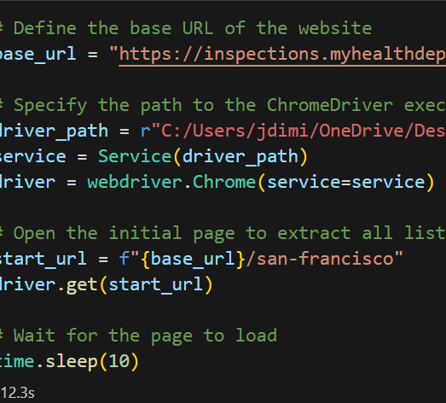
Web Scraping from Yelp
Can specific restaurant type predict violation risks(High, Moderate, and Low)?

Slide 11

Conclusion
In a city as vibrant as San Francisco food safety is essential. Machine learning can transform how to address public health challenges.

